Slide 1





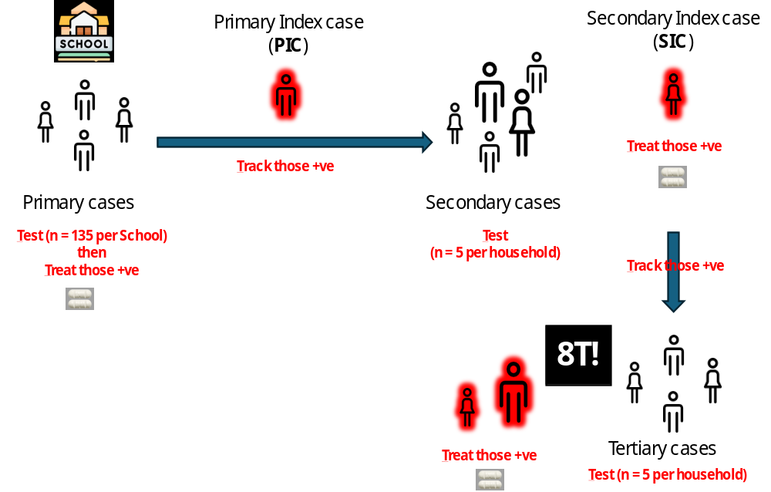
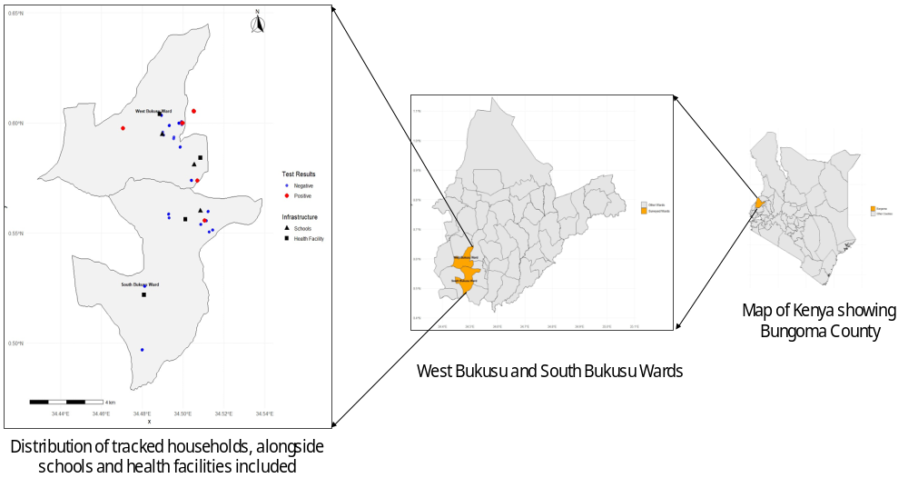
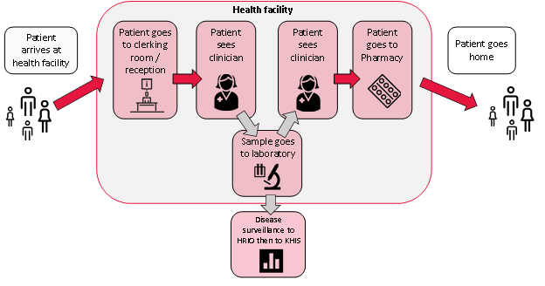
Moving Beyond Mass Drug Administration: Piloting the Test, Treat, Track, Test and Treat (5T) Strategy for Schistosomiasis Elimination in Low Prevalence Settings in Western Kenya
Dollycate Njagi^{1 *} ,Chitiavi Juma¹ , Maurice Odiere² ,Stella Kepha² ,Dickson Kioko³ , Martin Muchangi ¹ , Lenson Kariuki, Wycliff Omondi ³ ,Titus Waititu ³ , Hesbon Aoko ¹ , Faith Mutegi ¹ and Michael Ofire¹
1: AMREF Health Africa, Kenya, 2 Kenya Medical Research Institute (KEMRI):3. Department of Vector borne and Neglected Tropical Diseases- Kenya National Public Health Institute (KNPHI)
BACKGROUND
Following 4 rounds of mass drug administration (MDA) for schistosomiasis in western Kenya, many implementation units now approach very low prevalence (1–2%).
In such settings, MDA becomes less cost‑effective as most treated individuals are uninfected.
Targeted strategies that identify and treat remaining infected individuals while avoiding overtreatment are urgently needed.
The 5T strategy has shown promise in Egypt and Tanzania but has not been evaluated in Kenya.
OBJECTIVE: To evaluate the feasibility of implementing the 5T strategy for Schistosoma mansoni in two wards with very low baseline prevalence (1–2%) , and to determine the additional yield of positive cases through household contact tracking.
STUDY AREA:
South and West Bukusu Wards, Bungoma County
Baseline S. Mansoni
prevalence by Kato‑Katz: 1.7% (both wards)
Population: ~30,000 per ward
METHODOLOGY:
STUDY DESIGN AND SAMPLING
Design: Cross‑sectional survey with active case finding and contact tracing
School‑based: Children aged 5–14 years (3 primary schools)
Health facility‑based: Persons ≥5 years (3 dispensaries)
Sample size target: 1,200 participants (600 per ward)
Index case definition: POC‑CCA3 positive (Trace, 1+, 2+, or 3+)
Contact tracing: Up to 5 household members per index case (secondary cases), then up to 5 contacts of secondary cases (tertiary cases)
Figure 2: Schematic summarizing the flow of 5T based on sampling using the school platform
Component | Description
Testing | Urine POC‑CCA3 assay
Treating | Praziquantel (40 mg/kg) to all positive cases
Tracking | GPS‑guided household tracing with help from CHPs
Target per index | Up to 5 household members
Time to locate | Within 24 hours of index result
Figure 2: Study Area map
STATISTICAL ANALYSIS:
RESULTS
Figure 3: Schematic showing standard patient flow practice during passive surveillance for SCH at the health facility.
Table 1: Prevalence and yield per group
DISCUSSION
Group | N tested | Positive | Prevalence (95%CI
Primary cases | 1186 | 19 | 1.6% (0.97–2.49)
Secondary cases | 67 | 5 | 7.5% (2.47–16.6)
Tertiary cases | 16 | 3 | 18.8% (3.58–41.4)
TOTAL | 1269 | 27 | 2.1% (1.5–3.1)
The 5T strategy is feasible in low‑prevalence settings with good community acceptance
Schools are superior platforms for primary case detection compared to health facilities
The strategy identified 8 additional infections that would have been missed by routine surveillance
Low prevalence detected (2.1% overall) was lower than expected given POC‑CCA's superior sensitivity – raising concerns about batch performance of POC‑CCA3 kits used
Findings are comparable to similar 5T studies in Egypt (Ramzy et al., 2020) and Tanzania (Maganga et al., 2023; Trippler et al., 2024)
Schools detected 3.75× more PICs than health facilities (p < 0.001)
Schools yielded 0.5 positive secondary cases per PIC vs. 0.25 for health facilities
Table 2: Platform comparison
CONCLUSIONS
Platform | N tested | Positive | Prevalence (95%CI
Primary cases | 1186 | 19 | 1.6% (0.97–2.49)
Secondary cases | 67 | 5 | 7.5% (2.47–16.6)
The 5T strategy is feasible for schistosomiasis control in very low‑prevalence settings where MDA is no longer justified
School‑based platforms offer superior case detection yield compared to health facility platforms
The approach identifies residual infections and potential "superspreader" reservoirs that could perpetuate transmission
The 5T strategy should be considered for integration into routine primary healthcare services in Kenya as programs progress toward elimination
Quality control of POC‑CCA kits requires urgent attention for reliable field deployment
The 5T strategy identified 8 additional positive cases (5 secondary + 3 tertiary) beyond the 19 primary index cases – all received treatment.
All secondary and tertiary cases located within 24 hours
Female participants had 2× higher positivity than males (18 vs 9; p = 0.002)
Facilitating factors: CHP coordination, real‑time data tracking, timely remuneration
Challenges: POC‑CCA kit stability concerns, wrong participant details, stigma
Contact: [Dollycate.Njagi@amref.org]

Slide 2

Poster Size Guideline

